Slide 1

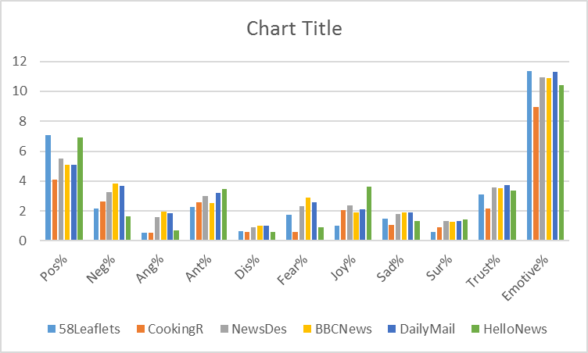
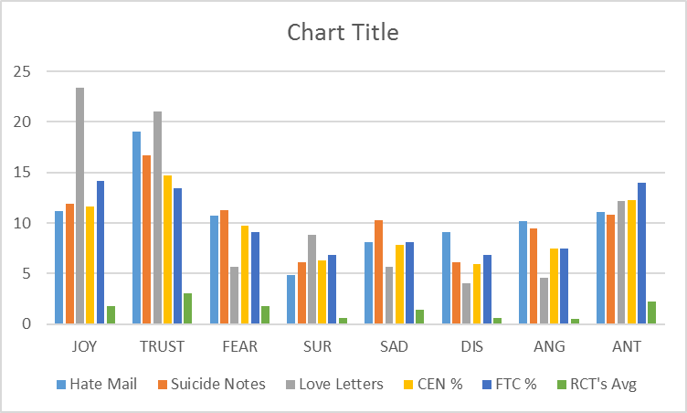
Web Analysis Techniques on Clinical Text:
Analyzing the effect of Emotive Text in Clinical Trials Recruitment and Retention
Fernando Santos | Prof Jeremy Wyatt | University oi Southampton
Research Questions
Procedure
Preliminary Results
How does a low emotive content affect the patient intention to participate in clinical studies?
Systematic Review
Finding emotional indicators
Qualitative Evaluation
Lab test to measure the indicators significance
RCT
Create a RCT to evaluate the effect of low emotive text in PILs
Evaluation
Analyze the results of the RCT and derive implications.
Hypothesis
A low emotive content in Clinical Text hinders the patients ability to understand and recall the information abut the study.
A low understanding of the study leads the patient to take decisions based on trust but generates uncertainty in the participants. This negatively impacts the retention rates of the clinical studies.
Data / Observations
A further analysis was required to ascertain the level of emotion present in common texts. This analysis was done on news articles and cooking recipes publicly available on the BBC and the daily mail and Hello Magazine Websites.
While still there is a low level of words related to emotions in most of the categories the differences are not as big as in the previous analysis.
Project Overview
This work is based in a previous MSc dissertation, we analysed the emotive text present in 58 publicly available Patient Information Leaflets for clinical trials supported by the NHS.
The emotive text was obtained by employing the NRC Emotion lexicon which contains emotional associations for 6520 English words.
During the first phase of the quantitative evaluation process a RCT in Mechanical Turk was proposed to evaluate the level of statistical significance of the presence of emotive words and the use of formal language.
Emotion is an inherent component of human interaction in part because it affects both the learning process and our memory (Mandler,1984; Bower, 1981, 1990,1992; Clark & Isen, 1982). It is no surprise that every social language contains a set of commonly-used words which primary use is to express the emotional state of the person.
On the other hand, medical language seeks to be completely objective and formal, in other words its principal objective is to “accurately describe components, conditions, process and procedures in a science-based manner” (Rector et al, 1999).
To reach these objectives it is quite common that medical text would disregard emotive words and phrases that are considered as subjective, with so few emotive content the patient would have a hard time remembering the content of the text as people store material in memory on the basis of its affective tone (Bower, 1994).
We believe this could hinder the patient ability to understand and recall important aspects of the clinical study and generate uncertainty and doubt in the participants. This could be reflected in lower participation rates and higher withdraw from studies before they end.
Conclusion
Preliminary Results
Initial research has show a statistically significant difference in the level of emotional words present in clinical information resources and those found in common texts.
Understanding the degree of effect that a low level of emotive words have in patient information resources have in their ability to understand and recall the study information is essential for designing this resources.
A low level of emotive content was detected during the analysis of the 58 Patient Information Leaflets. This was based in previous research done employing the NRC Emotion Lexicon to analyse novels, fairy tales, hate mail, suicide notes and love letters.
Works Cited
(Bower, 1981) Bower, Gordon H., Stephen G. Gilligan, and Kenneth P. Monteiro. "Selectivity of learning caused by affective states." Journal of Experimental Psychology: General 110.4 (1981): 451.
(Bower, 1990) Forgas, Joseph P., Gordon H. Bower, and Stephanie J. Moylan. "Praise or blame? Affective influences on attributions for achievement." Journal of Personality and Social Psychology 59.4 (1990): 809.
(Bower, 1992) Bower, Gordon H. "How might emotions affect learning." The handbook of emotion and memory: Research and theory 3 (1992): 31.
(Bower, 1994) Bower, Gordon H., Sharon Thompson-Schill, and Endel Tulving. "Reducing retroactive interference: an interference analysis." Journal of Experimental Psychology: Learning, Memory, and Cognition 20.1 (1994): 51.
(Clark & Isen, 1982) Isen et al. "Some factors influencing decision making strategy and risk-taking." Affect and cognition: The 17th annual Carnegie Mellon symposium on cognition. 1982.
(Mandler, 1984) Graf, Peter, and George Mandler. "Activation makes words more accessible, but not necessarily more retrievable." Journal of Verbal Learning and Verbal Behavior 23.5 (1984): 553-568.
(Rector et al, 1999) Alan L Rector Et al. Clinical terminology: why is it so hard? Methods of information in medicine, 38(4/5):239–252, 1999.

